Slide 1
Introduction – TA information
Name : P S Abhiram
You can contact me anytime if you have queries regarding the course at spand086@uottawa.ca

Slide 2
Tutorial information
We will be covering R programming for this term.
Lab timings:
A02 Tuesdays 13:00 – 14:20 SITE 2060
A06 Wednesdays 16:00 – 17:20 SITE 2052

Slide 3
In today’s class
Setting up R environment
Hello World!
Readability of R
Writability of R
Logical Operators in R
Vectors in R
If-Else in R

Slide 4
Prerequisites
CSI 2101 – Discrete structures. Why? Gives a good understanding to logical programming languages.
CSI 2110* – Programming paradigms. Why? Gives a good understanding about Object oriented programming, logical and functional programming.

Slide 5
Setting up R on your PC
R studio - https://www.rstudio.com/products/rstudio/download/#download
Ubuntu - https://youtu.be/kF0-FH-xBiE
Mac OS - https://youtu.be/LanBozXJjOk
Windows - Download R-4.2.1 for Windows. The R-project for statistical computing.

Slide 6
Why R?
R was created in the 1990s by Ross Ihaka and Robert Gentleman at the University of Auckland in New Zealand.
The R language was modeled based on the S language developed at Bell Laboratories by John Chambers and other employees.
Today, R is an open-source language; it’s accessible as a free software compatible with many systems and platforms.

Slide 7
R in Data Science
Open source: R’s open interfaces allow it to integrate with other applications and systems. Open-source software has a higher standard of quality and support.
Data Visualization: As a programming language, R provides objects, operators and functions that allow users to explore, model and visualize data.

Slide 8
R vs Python
When comparing R vs. Python, some feel that Python is a more general programming language.
R is used in statistical computing. RStudio is built around accompanying the features to be explored in R.
In terms of R vs. Python environments, the R environment is ideal for data manipulation and graphing.
R’s statistical packages are highly powerful.
R is generally used when the data analysis task requires standalone computation(analysis) and processing, while Python is used when integration with web applications is also required.

Slide 9
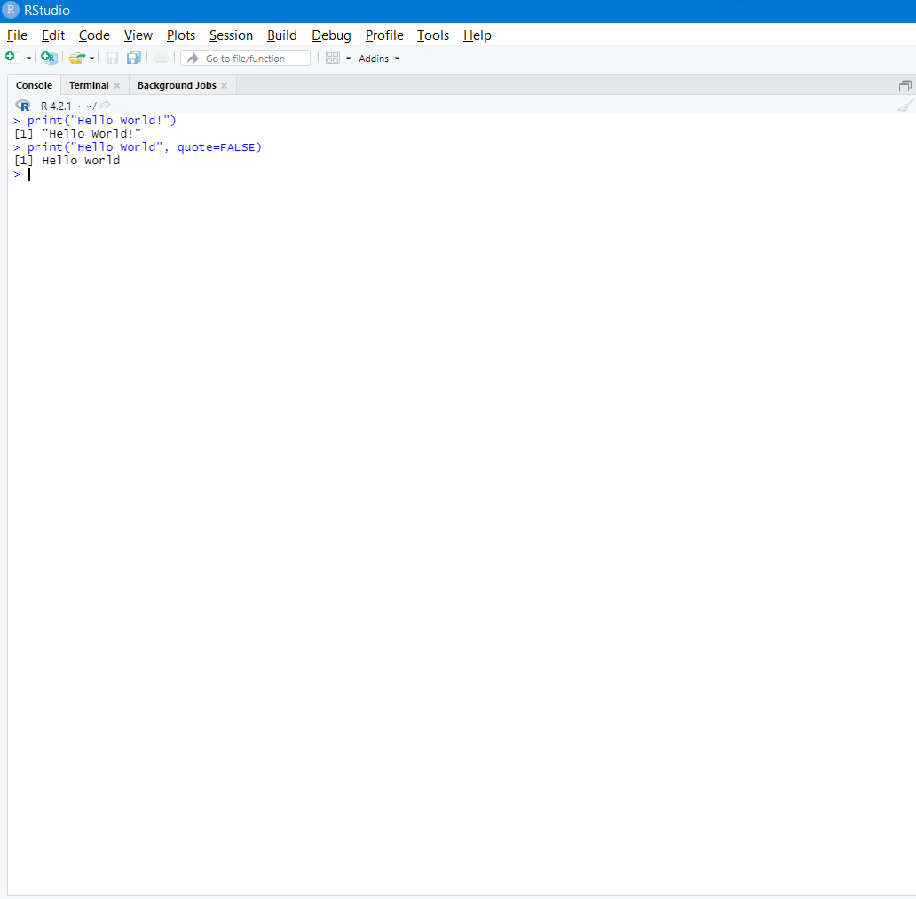
Hello World!

Slide 10
Basic R programming
Some basic terms to remember.
R console: This is where all the main logic usually takes place.
R script file: You can write different scripts and source them into your R console. Every time you make a change in a script file in the editor, save it, and to access that in the R console, use the ‘source’ function to source that file back into R.

Slide 11
Setting up a working directory
You can get your current working directory using the command ‘getwd()’.
Why is this important? If you want to read a csv file using the command ‘read.csv(“dataset.csv”)’, you will get an error if that csv file is not there in your current working directory.

Slide 12
Change working directory
You can change the working directory using the command:
setwd(#dir_name#) (please use forward slashes in path name to avoid any errors)
A recommended approach is to dedicate a directory to this course so that your work is not scattered, and minimize unwanted errors.

Slide 13
Readability
A simple addition of two numbers that the user inputs in Java:
import java.util.Scanner; // Import the Scanner class for taking user input
class MyClass {
public static void main(String[] args) {
int x, y, sum;
Scanner myObj = new Scanner(System.in);
// Input two numbers from User
x = myObj.nextInt();
y = myObj.nextInt();
//Calculate result
sum = x + y;
System.out.println(sum); // Print the sum
}
}

Slide 14
Writability
Consider a simple increment operator in Java.
int i = 2;
i++;
System.out.println(i);

Slide 15
Taking user input in R
scan() – Read input as a vector and for reading files.
Takes two parameters – filename and data type.
Eg: s = scan(“myfile.txt”, what = “ ”) //looks for strings in a file
readline() – Read input as a string.
as.integer() -> for integer conversion
as.numeric() -> convert to a float or double
as.complex() -> convert to complex number (1 + 2i)
as.Date() -> Convert to date, etc.

Slide 16

Assignment in R
Unlike in other programming languages where we use the equality operator (=) to assign values to a variable. In R we use “<-” operator.
Printing the variable can also be done in more than one way.
print(a) is known as

Slide 17
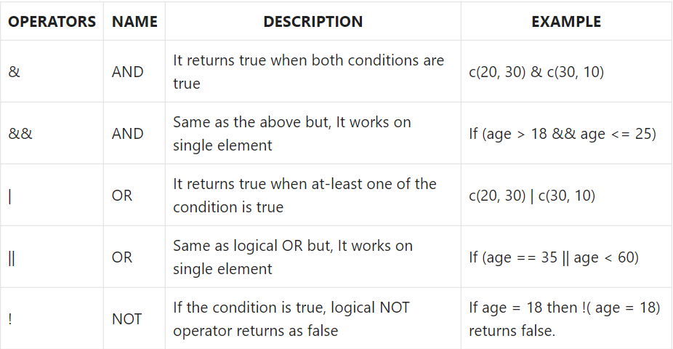
Logical operators in R

Slide 18
Vectors
R operates on named data structures.
The most used such data structure is a vector.
Creating a vector of 5 user defined numbers:
x <- c(1, 2,1.5, 2.5, 3)
Assigning a vector to a random variable:
assign(“x”, c(1, 2,1.5, 2.5, 3)) OR
c(1, 2,1.5, 2.5, 3) -> x

Slide 19
Concatenation of Vectors
We can perform concatenation of vectors the same way we do for strings:
y <- c(x, 0 ,x)
Above command creates a vector y with 11 entries with a 0 in the middle and an x on either side.

Slide 20
Math using Vectors
Vectors occurring in the same expression need not all be of the same length.
If they are not, the value of the expression is a vector with the same length as the longest vector which occurs in the expression.
v <- 2*x + y + 1
What would be the length of v here?

Slide 21
Character Vectors
Character vectors may be concatenated into a vector by the c().
The paste() function takes an arbitrary number of arguments and concatenates them one by one into character strings.
labs <- paste(c(“X”, “Y”), 1:10, sep=“”)

Slide 22
Check for missing values in a vector
When an element or value is “not available” or a “missing value” in the statistical sense, a place within a vector may be reserved for it by assigning it the special value NA.
Any operation on NA results in NA.
The function is.na(x) gives a logical vector of the same size as x with value TRUE if and only if the corresponding element in x is NA.
z <- c(1:3, NA)
ind <- is.na(z)
Copy non-missing values of x into y:
y <- x[!is.na(x)]

Slide 23
Some basic statistical methods
mean(x):
Takes in a vector x, and returns mean.
sum(x):
Takes in a vector x, and returns the sum of all elements in the vector.
sort(x):
Returns the input vector x in ascending order.
Please use the IDE to explore on how to do decreasing order.

Slide 24
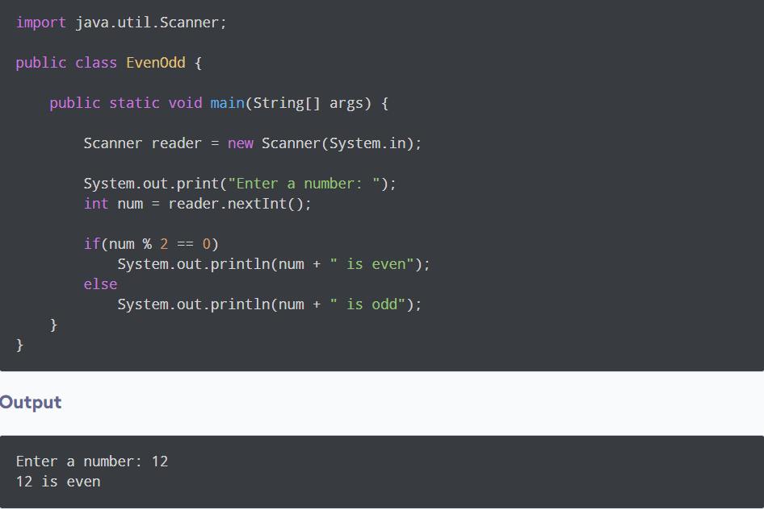
If-Else
Java vs R
Java code for checking if a number is even or odd:

Slide 25
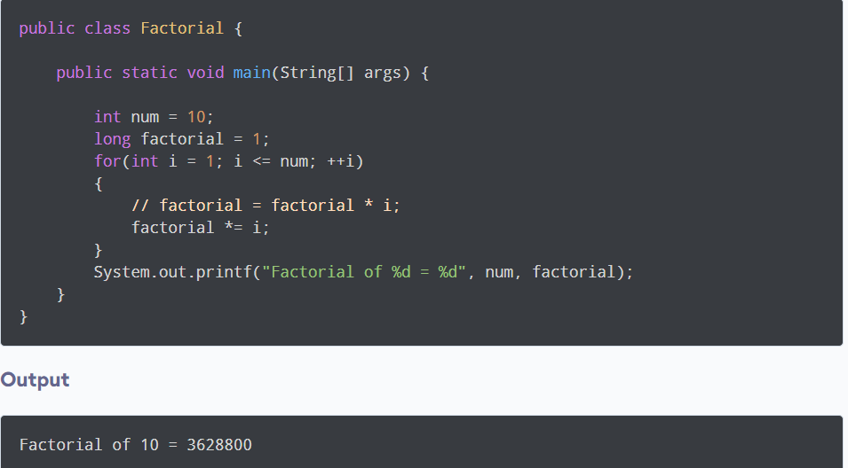
For loops
Java vs R
Java program to find a factorial:

Slide 26
Practice (please perform in a separate R source file)
Create a function that accepts a number, and prints “{number} is even” if the number is even, and vice versa if odd.
Create a function that calculates the factorial of a number. Please consider the edge case scenarios for this problem.
This is a two part question.
Part 1: Create a text file with integers separated by a space and save it in your working directory.
Part 2: Read the numbers and perform a cumulative sum over the numbers in the vector
Eg: sample1.txt – 123 456 789
Expected output: 123 579 1368
Hint: You can search for “cumulative sum in R”

Slide 27
References
An Introduction to R Notes on R: A Programming Environment for Data Analysis and Graphics Version 4.2.1 (2022-06-23). URL: https://cran.r-project.org/doc/manuals/r-release/R-intro.pdf
https://cran.r-project.org/doc/manuals/R-lang.html

